Slide 1
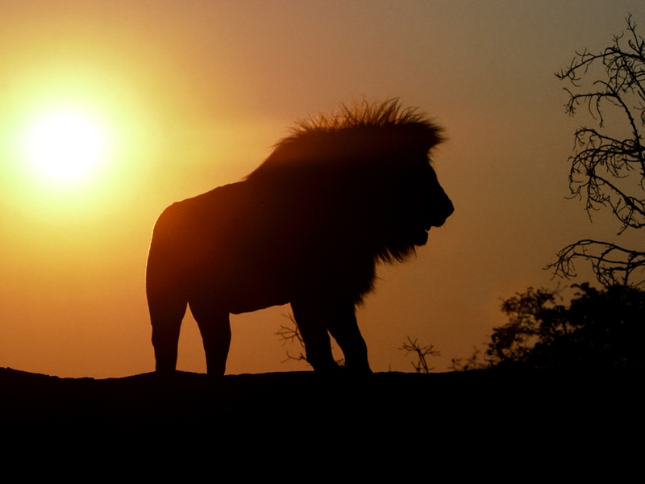
Oxidation - Reduction
RedOx

Slide 2
Oxidation States
. . . of an element are determined from the number of electrons that are ______ other atoms
  Gained from
  Lost to
  AND
  Shared with

Slide 3
Rules of assigning oxidation states
Atoms have a negative oxidation state if they have the higher e-neg in the bond
  NH₃
  N=⁻3
  H=⁺1
Oxidation states on
all the atoms of a molecule & compound
must add up
to equal zero

Slide 4
Uncombined elements free state
Elements that are not bonded to a different element have oxidation states of zero.
Al_{(s)} Cu_{(s)} Ag_{(s)} Cl₂ O₂ O₃ Ne

Slide 5
NOW More complicated . . .
H₂S
  sulfur has a -2 oxidation state
H₂SO₃
  sulfur has a +4 oxidation state
H₂SO₄
  sulfur has a +6 oxidation state

Slide 6
Assigning oxidation states to atoms in a polyatomic ion
Oxidation states on individual atoms must equal the charge on the ion
(S O₄)
(S⁺⁶ O₄⁻² )
(S O₄⁻² )
(SO₄)
+6
-8
= -2
-8
= -2
= -2

Slide 7
Try these . . .
hydroxide
dichromate
ammonium

Slide 8
Try these . . .
Hydroxide OH⁻ O=⁻2, H=⁺1
Dichromate Cr₂O₇⁻² Cr=⁺6, O=⁻2
Ammonium NH₄⁺¹ N=⁻3, H=⁺1

Slide 9
Assign oxidation states to each atom
NaOH
MnCrO4
(NH₄)₂SO₄
K₂O₂

Slide 10
Assign oxidation states to each atom
NaOH Na=+1, O=-2, H=-1
MnCrO4 Mn=+2, Cr=+6, O=-2
(NH₄)₂SO₄ N=-3, H=+1, S=+6, O=-2
KIO₄ K=+1, I=+7, O=-2
K₂O₂ K=+1, O=-1

Slide 11
RedOx reactions
Chemical reactions involving an electron transfer between reactants

Slide 12
Recognizing RedOx
assign oxidation states to the individual elements in reactants and the products
  if the oxidation state changes for some of the particles it is considered a RedOx reaction
Single Replacement Reactions are ALWAYS RedOX
Double Replacement Reactions are NEVER RedOX

Slide 13
In a RedOx reaction
If one atom is being oxidized another must be reduced.
In other words . . .
  oxidation and reduction always occur together
If electrons are lost by
one species in a reaction they
all MUST be
gained by another!

Slide 14
Oxidation
+3
+2
+1
0
-1
-2
-3
Oxidation results in an increase in oxidation state
Atoms that Lose e⁻lectrons undergo Oxidation
Metals tend to undergo oxidation

Slide 15
Reduction
+3
+2
+1
0
-1
-2
-3
Reduction results in a decrease in oxidation state
Atoms which Gain e⁻lectrons undergo Reduction
Non-metals tend to undergo reduction

Slide 16
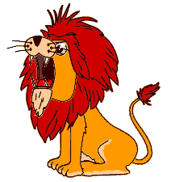
GeR

Slide 17
RedOx: Yes or NO?
HCl + NaOH → HOH + NaCl
Mg + 2HCl → MgCl₂ + H₂
MnO₂ + 4HBr → MnBr₂ + Br₂ + 2H₂O

Slide 18
RedOx: Yes or NO?
HCl + NaOH → HOH + NaCl
NO
Mg + 2HCl → MgCl₂ + H₂
YES
MnO₂ + 4HBr → MnBr₂ + Br₂ + 2H₂O
YES

Slide 19
Al + CuCl₂ ?
Predicting Products of
Single Replacement Reactions
Write a balanced equation based on these reactants.
Is this a RedOx reaction?
What species is oxidized?
  Reduced?

Slide 20
Al + CuCl₂ ?
Write a balanced equation based on these reactants.
2Al + 3CuCl₂ 2AlCl₃ + 3Cu
Is this a RedOx reaction? YES
What species is oxidized? Al⁰
  Reduced? Cu⁺²

Slide 21
Roaring Animals Often Attack
Elements that undergo oxidation cause reduction
  Reducing agent
Elements that undergo reduction cause oxidation
  Oxidizing agent
LEO GER
RA OA

Slide 22
2Al + 3CuCl₂ 2AlCl₃ + 3Cu
What is the Oxidizing Agent?
  Cu⁺² because it gets reduced
What is the Reducing Agent?
  Al because it gets oxidized
These answers always come from the reactant side

Slide 23
MnO₂ + 4HCl MnCl₂ + Cl₂ + 2H₂O
Assign oxidation states to all atoms
What species is oxidized?
  How do you know?
What species is reduced?
  How do you know?

Slide 24
MnO₂ + 4HCl MnCl₂ + Cl₂ + 2H₂O
Assign oxidation states to all atoms
What species is oxidized? Cl ⁻¹
  How do you know?
    Oxidation state increases from -1 to 0
    Cl⁻¹ loses electrons
What species is reduced? Mn⁺⁴
  How do you know?
    Oxidation state decreases from +4 to +2
    Mn+4 loses electrons

Slide 25
What species is the oxidizing agent?
  Mn⁺⁴ because it gets reduced
What species is the reducing agent?
  Cl⁻ because it gets oxidized

Slide 26
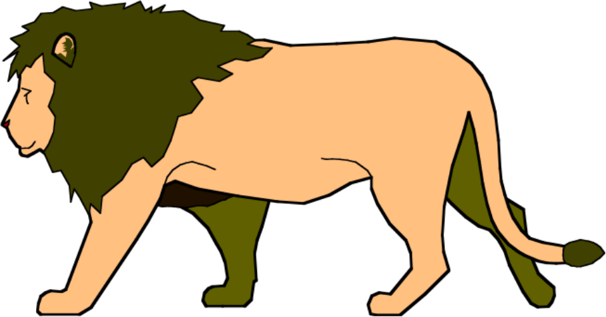
RedOx Practice
+4
+3
+2
+1
0
-1
-2
-3
-4
Remember . . .
Losing e⁻ oxidation
Gain e⁻ Reduction

Slide 27
Writing half-reactions
A half reaction shows either oxidation or reduction of a RedOx reaction.
The electrons being lost (oxidation) or gained (reduction) are also shown.

Slide 28
Oxidation half-reaction
Fe_{(s)} Fe⁺³_{(aq)} + 3e⁻
oxidation number increases
electrons are lost
  products
conservation of mass AND CHARGE
  charges on both sides equal each other

Slide 29
Reduction half-reaction
Sn⁺⁴ + 2e⁻ Sn⁺²
oxidation number decreases
electrons are gained
  reactants
conservation of mass AND CHARGE
  charges on both sides equal each other

Slide 30
Balancing RedOx using
1/2 reactions
COMING IN THE NEXT POWERPOINT!

